Slide 1
DRAG
There are many different types of drag. The most common are parasite drag, induced drag and wave drag.
Additionally, there are three types of parasite drag:

Slide 2
1. Form drag which results from the aerodynamic resistance to motion due to the shape of the aircraft.
2. Skin friction drag which is related to the smoothness (or roughness) of the aircraft surfaces.
3. Interference drag which occurs where surfaces with different flow characteristics meet (e.g. wing and fuselage).

Slide 3
During the movement of aircraft through the air (i.e. flight), all parts of the aircraft exposed to the airflow will produce an aerodynamic force that opposes the forward motion of the aircraft.
This opposing force is known as DRAG, and it acts parallel to and in the same direction as the relative airflow (RAF).

Slide 4
PARASITIC DRAG
Parasite (parasitic) Drag (PD) is defined as all drag that is not associated with the production of lift.
Parasite drag is caused by moving a solid object through a fluid medium.
In aerodynamics, the fluid medium concerned is the atmosphere. The principal components of parasite drag are form drag, friction drag and interference drag.

Slide 5
components of parasite drag
Form drag,
Friction drag
Interference drag.

Slide 6
Form Drag
Form drag, also known as pressure drag or profile drag, is caused by the separation of the boundary layer from a surface and the wake created by that separation. It is primarily dependent upon the shape of the object.

Slide 7
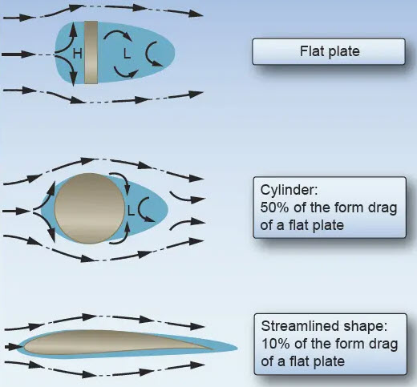

Slide 8
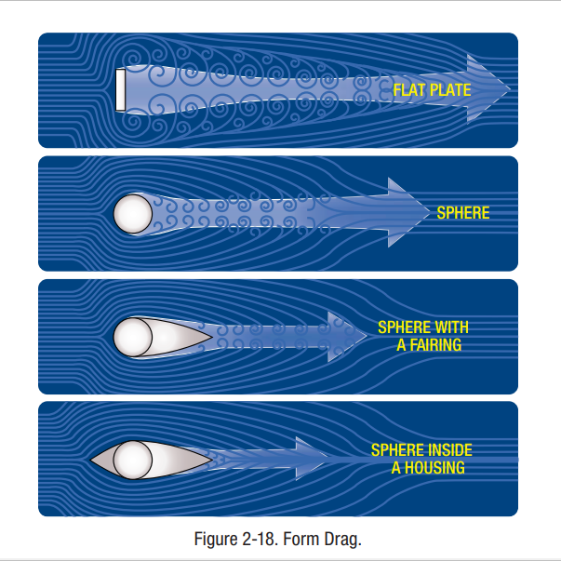

Slide 9
Form drag is the drag produced whenever the airflow that is passing over an object separates away from the surface becoming heavily turbulent. The separated flow behind the object producing a reduction in pressure that tries to pull the object back.

Slide 10
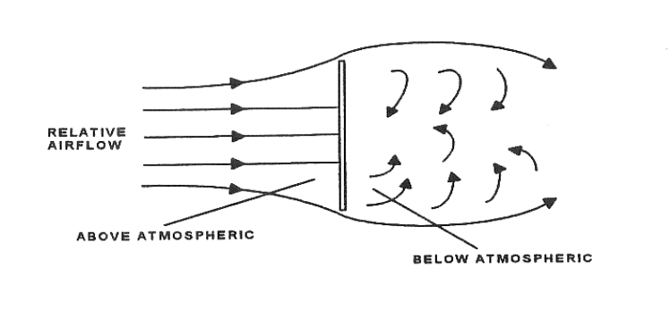
An extreme example of separated airflow and form drag can be seen when a flat plate is placed at right angle to the airflow.

Slide 11
The pressure immediately in front of the plate is above atmospheric pressure, due to the formation of stagnation points, whilst behind the plate the pressure will be below atmospheric due to the formation of vortices.
So that the aircraft pushes backward this drag is called as the form drag

Slide 12
The pressure differential between the leading and trailing edges of the plate causes the plate to be pushed in the direction of the relative wind and retards forward motion. This is form drag.
To reduce form drag, aircraft surfaces which are exposed to the airflow of the relative wind are streamlined.

